Slide 1
习题7.5
对于下列各（增广）文法，构造
① 规范LR项集族
② LALR项集族
  (3) S →S (S) S |ε
增广
S’ →S
S →S (S) S
S → ε
S →S (S) S |ε

Slide 2
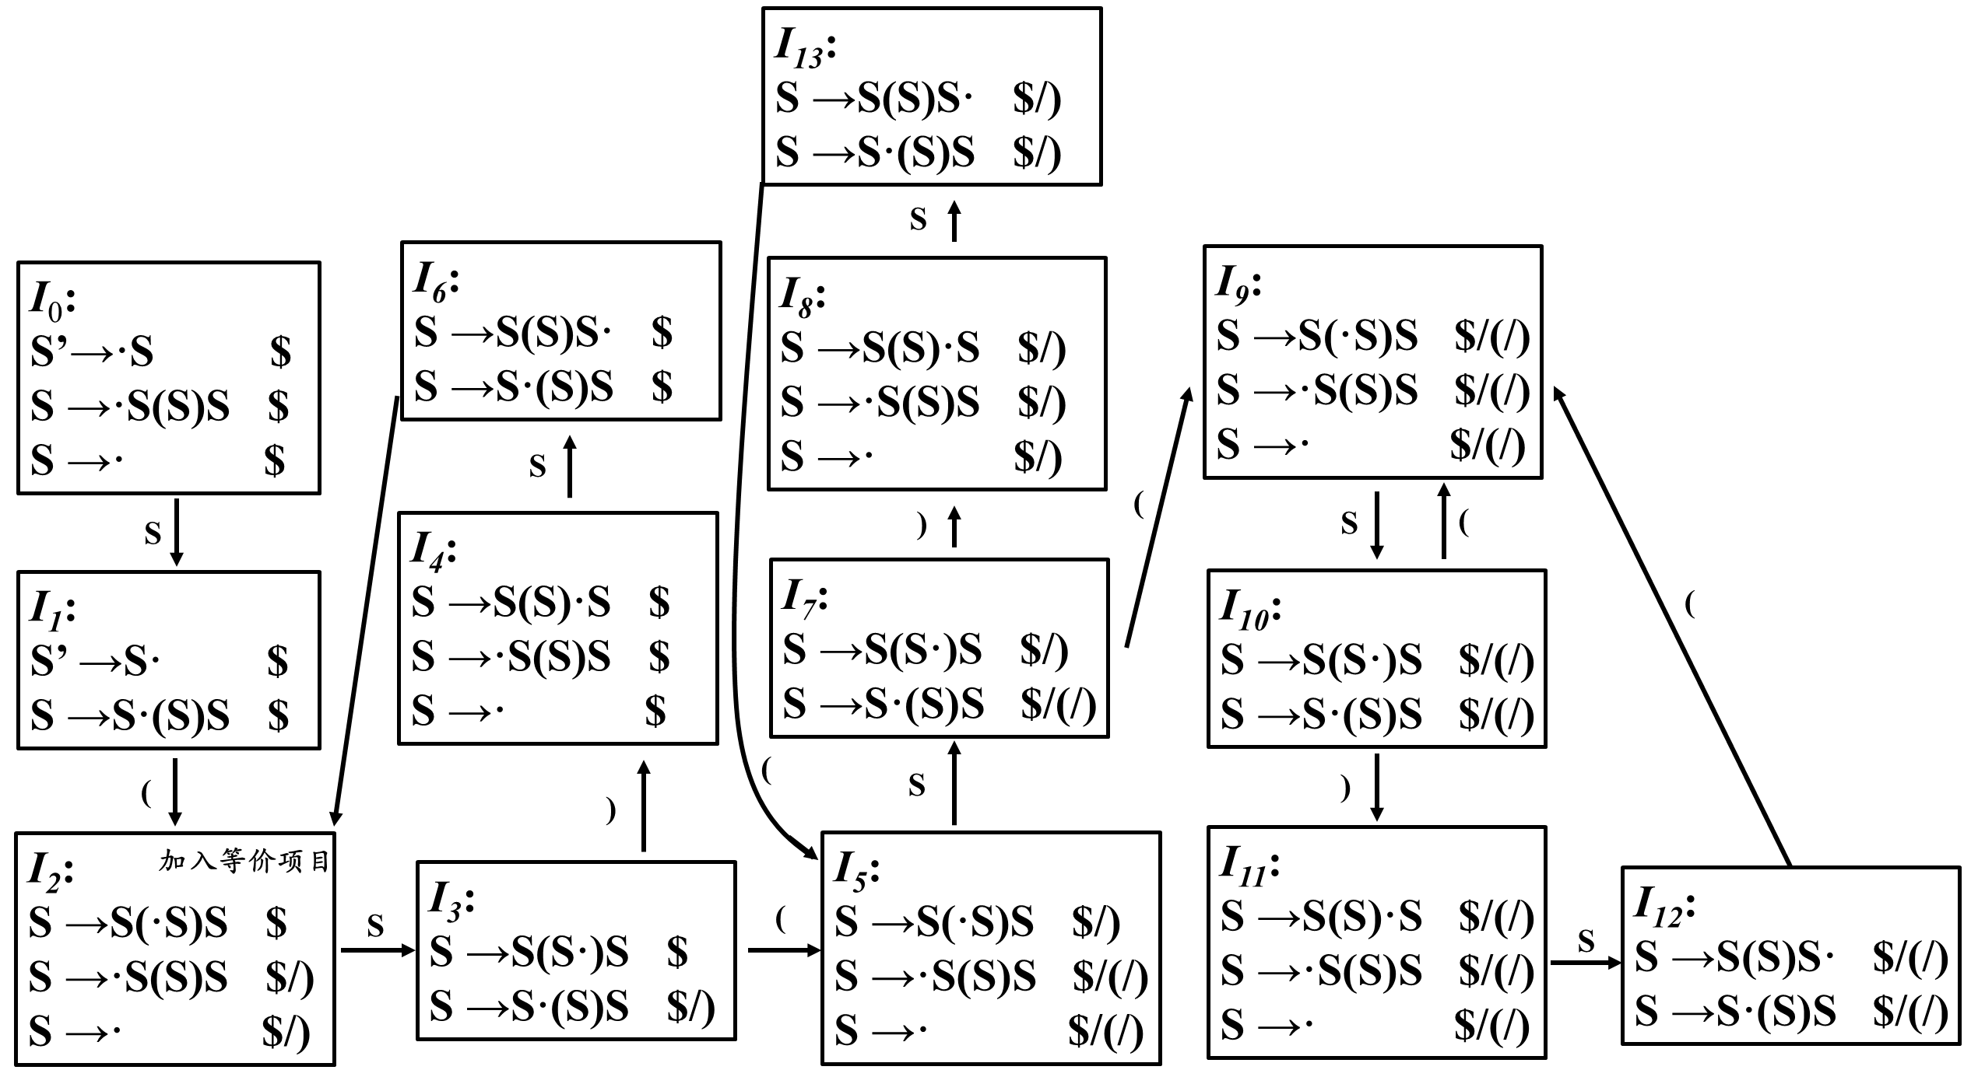

Slide 3
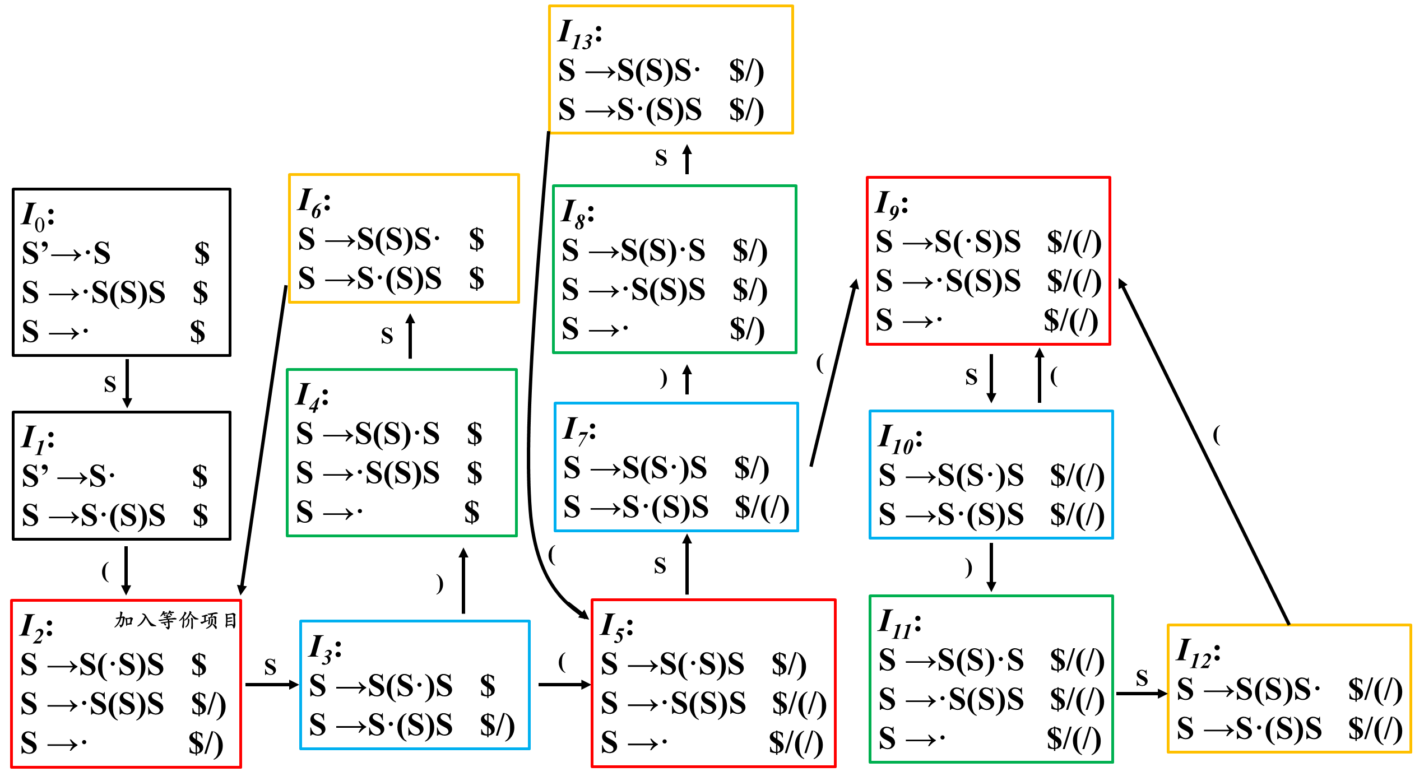

Slide 4
I₀:
S’→·S $/(/)
S →·S(S)S $/(/)
S →· $/(/)
I₃:
S →S(S)·S $/(/)
S →·S(S)S $/(/)
S →· $/(/)
S
S
I₂:
S →S(S)S· $/(/)
S →S·(S)S $/(/)
)
I₁:
S’ →S· $/(/)
S →S·(S)S $/(/)
I₄:
S →S(S·)S $/(/)
S →S·(S)S $/(/)
S
(
(
I₅:
S →S(·S)S $/(/)
S →·S(S)S $/(/)
S →· $/(/)
(

Slide 5
